Slide 1
Kickstart Scheme
In partnership with

Slide 3
About PTS
Professional Training Solutions started in November 2006. We are a Private Training Provider based in Farnham in Surrey with nationwide coverage.
We offer training in the following areas:
Traineeships
Apprenticeships Including:
Leadership and Management
Business Administration and Customer Service
Events
Accounts
Digital
Health & Clinical
Child Care & Education
And adding to our portfolio working with a range of employers
Fully funded courses in:
English & maths
Over 15 distance learning courses (eg Equality and Diversity)
Spectator Safety
Commercial Courses:
Emergency First Aid at Work/Health & Safety
Stress & Resilience

Slide 4
About PTS
Quotes from our 2018 OFSTED Report:
Leaders have rapidly established Professional Training Solutions Limited as a good-quality independent learning provider, building on their experience of being a subcontractor.
Managers and assessors monitor apprentices’ progress very closely. As a result, the very large majority of apprentices make good progress.
Leaders and training staff develop and maintain excellent relationships with employers and partners. They ensure that learning programmes closely meet the needs of employers, apprentices and adult learners in management, early years and health and social care.
Current learners on recently introduced teaching assistant and care programmes for adults make very good overall progress, and the vast majority achieve their qualifications.
Adult learners and apprentices develop very good work-related behaviours and skills in care and management programmes. Their attendance and punctuality are good and they are highly motivated to learn and achieve.
Trainers and assessors have a detailed knowledge of their subjects, which they use well to motivate learners and apprentices.

Slide 5
What is a Kickstart Gateway?
A Kickstart gateway is an organisation that has shown interest in representing employers who want to apply for 29 or less job placements. Kickstart gateways can be any type of organisation.
DWP performs due diligence checks on these organisations.
What do we receive:
£300 to administer each placement:
Reimbursement of the employer grant/salary/NI/automatic enrolment.
Contract with the employer.
Support with recruitment.
Liaison with Jobcentres.
Tools, processes and procedures to ensure employer is compliant.

Slide 6
What is the Kickstart Scheme ?
The Kickstart Scheme is a £2 billion fund to create hundreds of thousands of high quality 6-month work placements for young people 16-24 years old.
Funding available for each job to cover the relevant National Minimum Wage for 25 hours a week, plus the associated employer National Insurance contributions and employer minimum automatic enrolment contributions.
Employers receive a grant of £1,500 per participant to support them to develop new skills/set up and to help them move into sustained employment after they have completed their Kickstart funded job.
The young person must be registered with their local Job Centre accessing Universal Credit.

Slide 7
Employer Eligibility Criteria
Employers must have a company or charity number (current requirements).
Employers must have new job placements created for the Kickstart funding. They must not be:
Replacing an existing or planned vacancies.
Cause an existing employee or contractors to lose or reduce their employment.
The new Kickstart roles must be:
A minimum of 25 hours per week, for 6 months.
Paid at least the National Minimum Wage for their age group
Should not require people to undertake extensive training before they begin the job placement.
Applications should include how the employer will help the participants to develop their skills and experience with:
Support to look for long-term work.
Support with CV and interview preparation.
Training to develop their skills, such as teamwork, organisation and communications as part of the role.
https://assets.publishing.service.gov.uk/government/uploads/system/uploads/attachment_data/file/919132/kickstart-employer-guide-7.0.pdf

Slide 8
Employability
Kickstart is a great opportunity for employers to move their business forward with the support of the government, but at the heart of this scheme is the participant themselves.
The roles that should be put forward should be real with a genuine intention to make a difference to the participant with a view to support them into sustainable employment.
The £1,500 grant that the government will give all employers per kickstart job role can only be used for set up costs and to support the young person to develop their employability skills. This can include:
Laptop
Payroll set up
DBS
Uniform
Employability Training
Other training to support them progress within the placement and offer the participant more skills that will benefit them moving into a sustainable job or apprenticeship.
As part of our offer to our Kickstart employers we will be offering a package of training and support which includes remote training for the Kickstart participants, so they can gain a recognised employability qualification and monthly remote 1-2-1 mentoring sessions to support the participant flourish in their new workplace. The cost of this training is £495+VAT, this would come out of the employers £1,500 grant, should you wish to take up our training offer.
HMRC also have the right to audit any company that is offering Kickstart roles and will expect to see an audit trail of the £1,500.

Slide 9
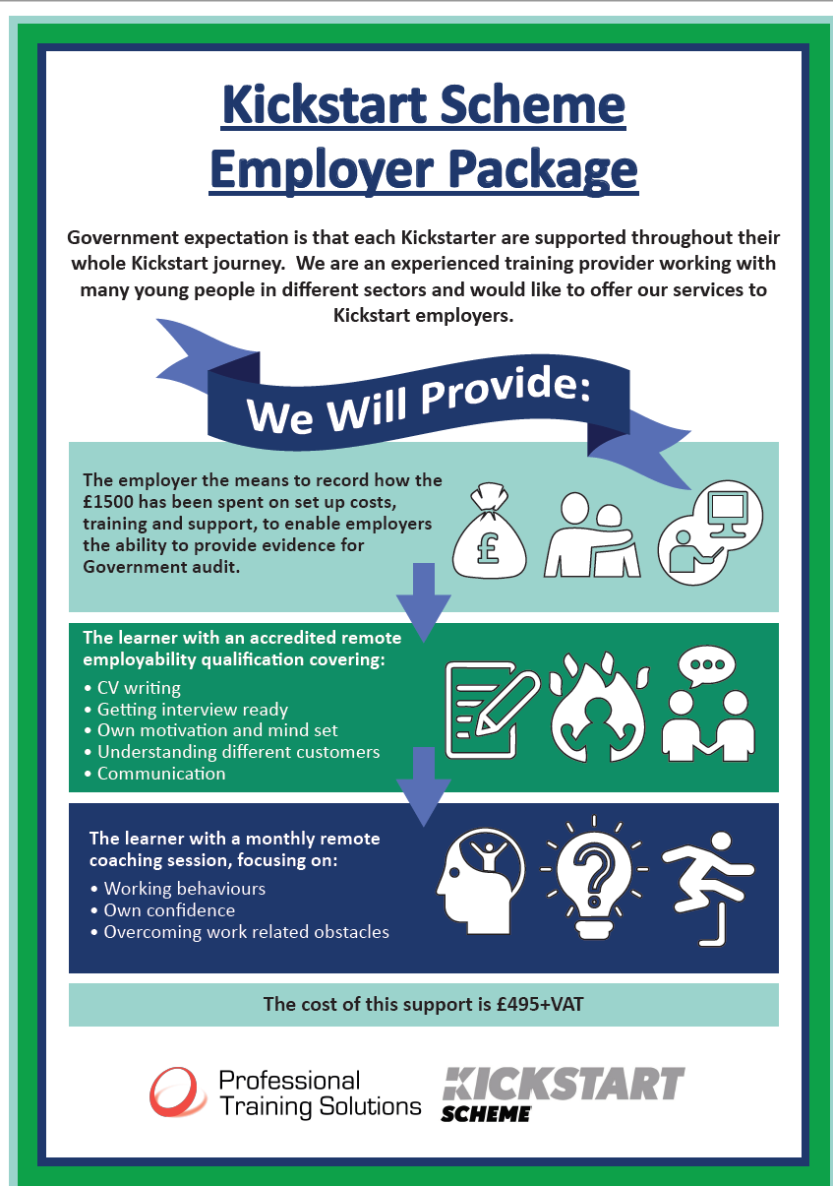

Slide 10
The Kickstart Participant
To be eligible for a Kickstart position, the young person must be:
Aged 16-24
Claiming Universal Credit
At risk of long term unemployment
You may have a person in mind for your Kickstart position, but the young person must be registered on Universal Credit, which they can do using the below link:
https://www.gov.uk/apply-universal-credit
If the person is already on Universal Credit then they simply need to talk to their Work Coach at their local Jobcentre so they can support the job match or log onto their Universal Credit app and make a journal entry with the employers details so that their Work Coach can take the information and support the job match.
The vision is that after 6 months the participant has done enough to be considered for;
a permanent position
an apprenticeship (We can support you with the delivery of apprenticeships)
However, if this isn’t an option, support, information, advice and guidance needs to be given to the participant to make their next positive step forward towards sustained employment. We will support you in providing this as part of our employability training package.
Please also be aware that the participant may not wish to work for you after the 6 month placement.

Slide 11
How and When will you Receive the Funding?
The £1,500 Employer Grant will be paid when the young person starts the job placement (via the Kickstart Gateway).
DWP will use information from HMRC to check that the young person is still employed. The grant funding to pay the young person’s salary will be paid in monthly arrears (via the Kickstart Gateway) when we know they are:
enrolled on the employer’s payroll
being paid through Pay As You Earn (PAYE)
The employer can pay a higher wage and for more hours but the funding will not cover this.

Slide 12
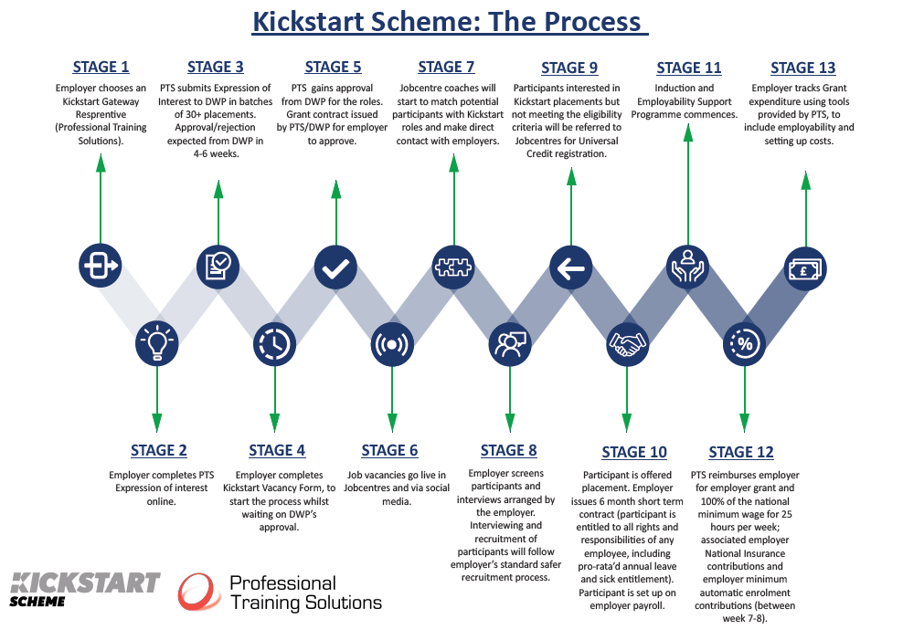

Slide 13
Interested and Next Steps?
Please click here to complete your Expression of Interest. It shouldn’t take you any more than 10 minutes to complete and only indicates your expression of interest at this stage.
If you wish to discuss this further, or talk to us about your placements, please call:
Chrissy: c.payne@protrain-solutions.co.uk; 07957 594059
Jackie: j.denyer@protrain-solutions.co.uk; 07775 732880

Slide 14
